Slide 1
Find a task on a customer account
GVA SI - NETCRACKER

Slide 2
Find the customer’s account

Slide 3

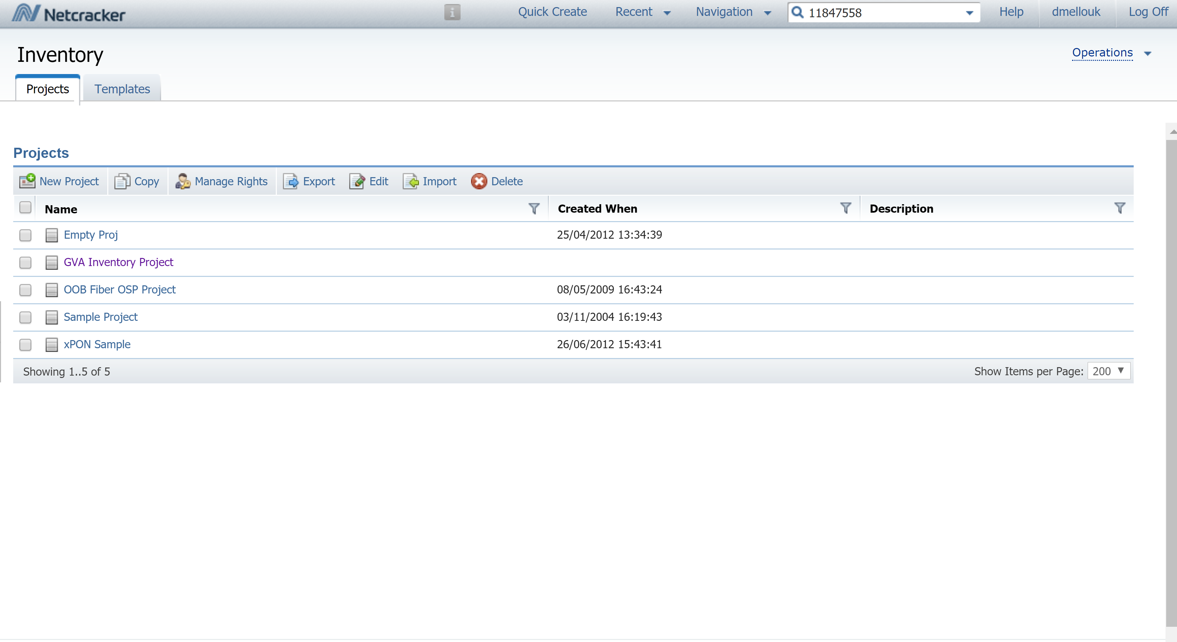
Customer account How to access it
NOC
dmin
From Netcracker’s hompeage, copy and paste the account number in the search field then press « enter »
From the home page you can either look for a customer account or any other object : building, pole, otb, odf,…

Slide 4
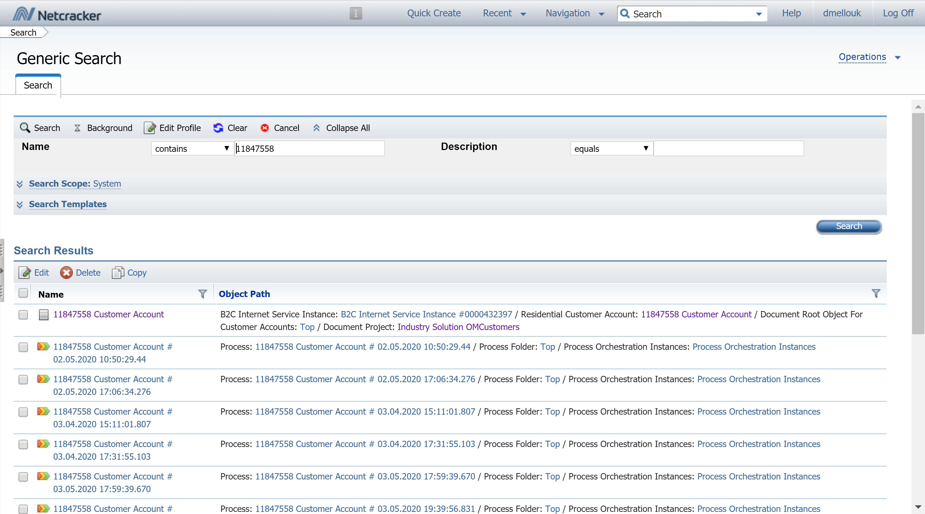
Customer account How to access it
NOC
dmin
Click on the first link of the search results that represents the customer account in the system

Slide 5
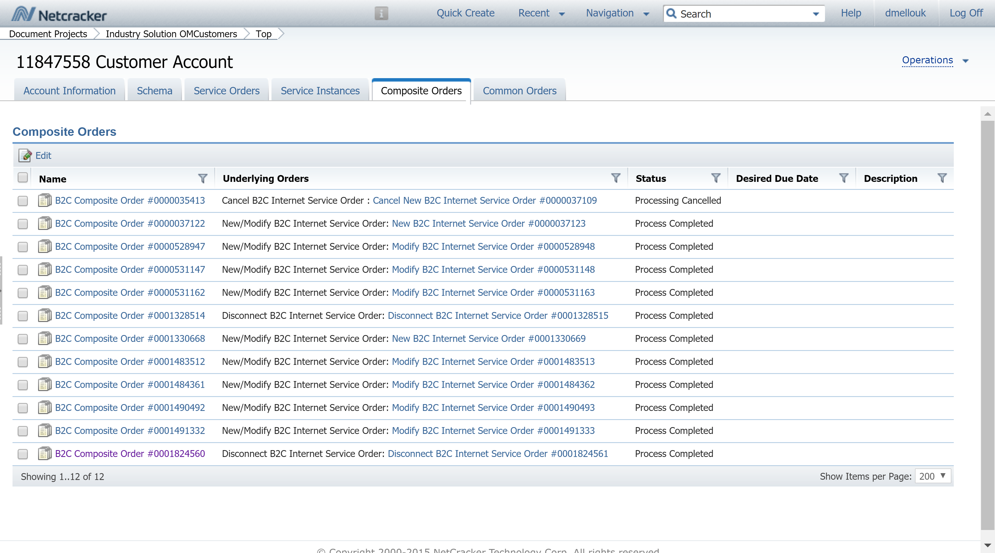
Customer account Select the correct workorder
NOC
dmin
Click on the « Composite Orders » tab and then click on the work order you are looking for
Work orders are listed from the eldest to the newest, from top to bottom. For example here I will be selecting the last one. I can see in the second column that it is a Disconnect order and that it is completed

Slide 6
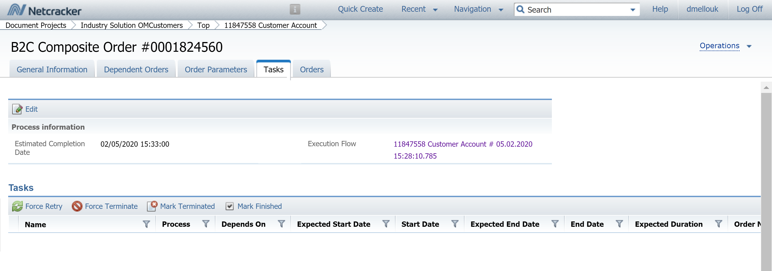
Composite order Check and select
NOC
dmin
Click on the « Tasks » tab and then click on the execution flow to continue.
Remember to check the data of the orders to see if you pick the correct one from the previous screen

Slide 7
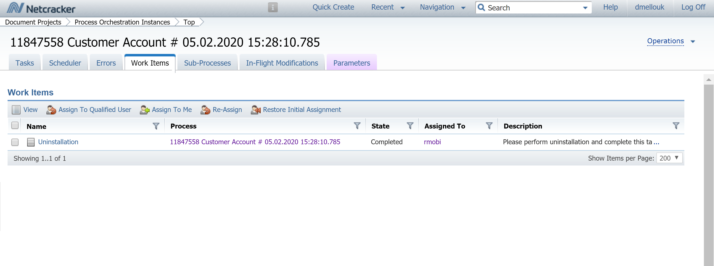
Tasks Check for work items
NOC
dmin
Click on the « Work Items » tab and then you will see if the there is a task and if it has been completed and by whom ☺

